Slide 1
Proposed Institutional & Legislative Reforms and the draft RBM Act 2012
(with contemplated revisions)
Er. M. Gopalakrishnan FNAE, Hon Diplomate of AAWRE
Formerly Secretary General, International Commission on Irrigation and Drainage
Ex- Member CWC, Member TAC, World Water Development Report Series WWAP
Ex President IWRS, Ex-Governor World Water Council and President NDC WWC

Slide 2
Water Resources Development &Management at its cross roads
With the increasing population, a need is emerging strongly for better water governance.
In order to have better management of water resources for domestic, agricultural, industrial and environmental needs, and to get rid of the present day problems in water sharing due to increasing water stress day by day, a Committee was recently constituted to consider relevant aspects by revisting the River Board Act 1956 and suggest appropriate revisions

Slide 3
The Setting as it obtains…
A number of judgments by the Hon’ble Supreme Court of India in recent times call upon the State to conserve and preserve water resources and share it to other co-riparian, given the acute shortage of surface water and river flows, and the decline in ground water level.
Increasingly, it is felt that the existing legislations on water are inadequate in meeting the aspirations of the States; and, a new legislation that enable the States which share river basins, should be brought in by the Centre.
And, it would be expedient in the public interest that the Central Government take under its control the regulation and development of inter-State rivers and river valleys to the extent required, to enable optimal Water Management.

Slide 4
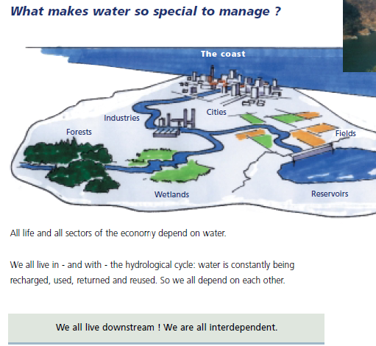
River Basin Management Approach
Sharing of some International Experiences on RBM had taken place in the previous sessions
A need for enabling provisions was dinstinct
A RBM Act to address the issues better in the Indian context so as to create an enabling environment for Integrated River Basin Management (IRBM) is the scope of my talk based on official available documents

Slide 5
Water in Our
Indian Constitution
The current situation

Slide 6
Entry 17, List II of Indian Constitution
The Constitution of India lays down the legislative and functional jurisdiction of the Union, State and local Governments regarding 'Water'. Under the scheme of the Constitution, 'Water' is basically a State subject and the Union comes in only in the case of inter- state river waters.
List II of the Seventh Schedule, dealing with subjects regarding which states have jurisdiction, has the following as Entry 17 :
  "Water, that is to say, water supplies, irrigation and canals, drainage and embankments, water storage and water power subject to the provisions of Entry 56 of List I .
Entry 56 of List I (Union list), reads as follows:
"Regulation and development of inter- state rivers and river valleys to the extent to which such regulation and development under the control of the Union is declared by Parliament by law, to be expedient in the public interest".

Slide 7
Disputes Resolution
The Constitution has a specific article (Article 262), dealing with adjudication of disputes relating to matters of inter- state rivers or river valleys. This provides:
  Article 262
  (1): Parliament may by law provide for the adjudication on any dispute or complaint with respect to the use, distribution or control of the waters of, or in, any inter- state river or river valley.
  (2) Notwithstanding anything in this Constitution, Parliament may by law provide that neither the Supreme Court nor any other Court shall exercise jurisdiction in respect of any such dispute or complaint as is referred to in clause (1).

Slide 8
The 1992 amendments to Constitution cover ‘Panchayats &Municipalities’ which, inter-alia, indicate their role on water…
Following entries in the schedules listing the subject-areas in which the State Governments and legislatures may devolve functions to such bodies, so as to make them evolve as local self-governing institutions:
  In the Eighth Schedule (Part IX) dealing with Panchayats, the subjects, ''Minor irrigation, Water management and Watershed development", "drinking water" and "maintenance of community assets" are listed.
  In the Twelfth Schedule (Part IX A) dealing with municipalities, the subjects "water supply of domestic, industrial and commercial purposes" is listed.
Notwithstanding the role of States regarding ‘Water’ , we find that functional responsibilities for local Governments in respect of several aspects of water use are within their rights.

Slide 9
At Cross roads: The complexity of Integrated Water Management & Development of Resources for future expanding needs
  Notwithstanding available provisos as per the Constitution, a well ‘updated basin wise’ integrated water resources development and management plans for various inter-state basins, ensuring convergence among various water resources programmes is still a dream!
  We have to look ahead and proceed with several aspects like
      Expansion of hydrological observation network for a reliable Water Data Base
      Modernization of the National flood forecasting network for disaster mitigation & Expansion of inflow forecasting for major reservoirs in the country
      Validated Water resources information system (WRIS)
      Intensive push in the area of major, medium, multipurpose and minor irrigation projects, flood management etc., with a particular focus on Management at basin level
      Issues related to Dam Safety at basin level &
      Tidal Areas, Mangroves and Coastal Management
  We also find that the Climate Change activities identified under National Water Mission(NWM) addressing new Water Challenges require a fresh in-look at ‘basin level’, using IWRM approach

Slide 10
Expert Committee of Multi Disciplinary nature to address the issues and study the activities required for an Optimal development of River Basins and desirable changes required in the existing River Board Act, 1956

Slide 11
Composition of the GoI Committee (2012)
CHAIRMAN
Justice Shri Tejinder Singh Doabia, Former Chief Justice of M.P. & J&K High Court
Members (external to GoI)
Shri S. Manoharan, Former Special Secretary, Ministry of Water Resources
Shri M. Gopalakrishnan, Former Member, Central Water Commission & Ex Secretary General, International Commission on Irrigation Drainage,
Shri B.P. Das, Former Engineer in Chief, Water Resources Department, Government of Orissa
Shri S.G. Bhogle, Ex-DG, Water and Land Management Institute (WALMI), Aurangabad
Shri Videh Upadhaya, Legal Consultant and Specialist on Development and Natural Resources Law
GoI Officers representatives in the Committee as Members
Shri Rajesh Kumar, Member (WP&P), Central Water Commission
Shri A.B. Pandya, Director General, National Water Development Agency
Shri Pradeep Kumar, Commissioner (PR), Ministry of Water Resources as the Member-Secretary

Slide 12
ToR for GoI ‘River boards Act’ Committee
To identify the main ingredients of a comprehensive River Valley Development Plan which need to be brought under a legal framework for effective implementation and suggest appropriate structure for an Inter-State River Valley Development Act and recommend a legal framework to facilitate smooth implementation of the river valley plan;
Suggest provisions required in law to bring about integrated water resources development with the participation of all key stake holders;
Suggest how the fundamental features of the plan can be made mandatory preventing deviations by the stakeholder Sates;
Suggest means of ensuring accountability of the States in the faithful implementation of the River Valley Development Plans;
Delineate the responsibilities of the Government of India and the State Governments. Also indicate the extent to which some of the responsibilities can be delegated to the States without compromising the lead role of the Central Government;
Suggest the legal provisions for ensuring the smooth flow of all the data required for river valley planning and implementation of the plan

Slide 13
Statement of Objectives and Reasons
Entry 56 of List I of the Seventh Schedule to Article 246 - “Regulation and Development of Inter State Rivers and River Valleys to the extent to which such regulation and development under the control of the Union is declared by Parliament by law to be expedient in the public interest”
Parliament enacted the River Boards Act, 1956 (Act 49 of 1956) in pursuance of above
This Act has fallen into disuse as no River Board has been ever constituted under this Act. It is proposed to be repealed.
Some key ‘Limitations’ discernible in the ‘RIVER BOARD ACT, 1956’:
  Absence of concepts like Basin, Sub-Basin, Integrated River Basin Management and River Basin Master Plan,
  No mandatory nature of the provisions,
  Absence of any Political representation (in River Boards) and
  The Lack of mechanism of ‘Dispute Redressal’ and enabling ‘binding provisions’

Slide 14
The proposed RBM Act
Draft as finalised in terms of reference assigned to the Special MoWR Committee chaired by Justice Doabia in 2012

Slide 15
Proposed RBM Act (as per MoWR’s Special committee on the subject matter, constituted in 2012 and its draft version)
An act to provide the establishment of River Basin Authority for the Regulation and Development of Inter State Rivers & River Basins
Contains a Preamble and 11 Sections dealing with Specific Aspects and supplemented by two Annex.
The nine Sections including Preamble have a total of 34 paras detailing different aspects, precisely and clearly.
These Sections are:
I Preamble | II Definitions
III Principles governing River Basin Development Management & Regulation | IV Inter State River Basins
V Establishment & Constitution of River Basin Authorities | VI River Basin Master Plans
VII Powers & Functions of RBAs | VIII Dispute Resolution
IX Funds, Accounts & Other matters
Schedules I & II

Slide 16
The draft R B M Act
  The Act proposed is in order to facilitate establishment of “River Basin Authorities” for the regulation and development of Inter-State Rivers and River Basins
  Principles governing River Basin Development, Management and Regulation in line with the draft National Water Policy - 2012 …..
    Participation
    Cooperation
    Equitable and Sustainable Utilisation of water
    Conjunctive Management
    Integrated Management
    Water as a Common Pool Community Resource
    Demand Management
The proposed River Basin Authority(ies) shall commence with a River Basin Master Plan for the river basin development & management and regulation under its jurisdiction

Slide 17
The draft River Basin Management Act…2
  The River Basin Master Plan shall, inter-alia, include
    all the results of the analysis of the River Basin Characteristics
    a comprehensive review of the impact of anthropogenic interventions on the status of surface water and ground water, including an estimation of pollution, point as well as diffused, in water uses
    identification of protected areas, social and cultural flow needs and duration
    environmental needs
    ground water and protected aquifers, if any
    a summary survey of existing pricing policies and an economic analysis
    a fair assessment of the effects of existing legislations
    an economic analysis for optimal allocation and the notional cost of deviation from optimal

Slide 18
The draft River Basin Management Act…3
  River Basin Authority – A Two Tier System is envisaged
  A Governing Council and an Executive Board
  Governing Council : Constitution –
    From each basin State (defined as interested States)
      Chief Minister(s)/ Ministers (WR); one MP (Lok Sabha); One MLA, Two representatives of District Panchayat / Zilla Parishad; Chief Secretaries; One representative from the WUA; One representative from the Urban Local Bodies, Two independent experts to be nominated by the State Government
    Three independent experts to be nominated by the Central Government
    Member-Secretary who shall be the Chief Executive Officer of Executive Board – not below the rank of ‘Member, CWC’

Slide 19
The draft River Basin Management Act…4
  Executive Board: Constitution
Chief Executive Officer – of the rank of ‘Member , CWC’;
From the basin States concerned/interested - Secretaries – Water Resource, irrigation or flood control, Agriculture, Power, Environment;
From each basin State - Engineer in Chief (water resources, irrigation or flood control); Member-Secretary - State Pollution Control Boards; A Representative , not below the rank of Chief Engineer, of the State Groundwater Board; Managing Director / Member-Secretary of the State Water Supply and Sewerage Board; Member Secretary - State Disaster Management Authority
Regional Director(s), Central Groundwater Board
One person to represent NGOs and one expert, dealing with river basin and water resources management to be nominated by the State Governments of each of the basin States;
Member-Secretary of the Board, - The concerned Chief Engineer of the Central Water Commission in the field formations of CWC.

Slide 20
The draft River Basin Management Act…5
  Governing Council : Functions–
To approve the river basin master plan;
To facilitate implementation of approved river basin master plan;
To make recommendations in relation to the coordination of basin State activities with a view to resolve conflicts among them;
To make recommendations for conservation, control and optimum utilisation of water resources;
To forward every approved Scheme made under this Act to the Governments interested, with such advice as required &/or solicited, to undertake measures for executing the Scheme;
To allocate, among the Governments interested, the costs of executing any scheme, prepared by the River Basin Authority;

Slide 21
The draft River Basin Management Act…6
  Governing Council : Functions–
To review and according clearance to new water resources projects
To lay down policies and to make recommendations for promoting efficient use of water;
To approve the water account prepared by the Executive Board;
To take steps to see that sewerage, sullage water and other pollutants are not discharged into rivers under its jurisdictions.
Any other matter which is supplemental, incidental or consequential to any of the above functions.
The recommendations of the river basin authority shall be final and binding on all parties.

Slide 22
The draft River Basin Management Act…7
  Executive Board: Functions–
To formulate River Basin Master Plan(s);
To prepare schemes, including multi-purpose schemes, in accordance with the River Basin Master Plan;
To ensure compliance of the decisions taken in the Governing Council in respect of River Basin Master Plan.
To maintain and regularly update a comprehensive water database;
To conduct a comprehensive scientific survey, investigation and assessment of water resources in respect of new projects.
To monitor the progress of the measures undertaken in implementing the River Basin Master Plan by the Governments interested and report to the Governing Council on the same;

Slide 23
The draft River Basin Management Act…8
  Executive Board: powers for efficient discharge of functions ..2
Acquire, hold and dispose of property, both movable and immovable
Undertake or cause to undertake such investigation or surveys or other measures for development, management and regulation of water resources.
Inspect or cause to be inspected any works undertake by any Government interested concerning regulation or development of inter- state river basin.
Conduct and Co-ordination or cause to conduct and co-ordination research on various aspects of conservation, regulation or utilization of the water resources.
            Contd…..

Slide 24
The draft River Basin Management Act…9
  Executive Board: powers for efficient discharge of functions …3
Collect or cause to be collected such topographical, geological, meteorological, hydrological, sub soil water data, land use and soil related Data.
Publish or cause to be published statistics or other information relating to various aspects of regulation and development of inter-state river basin.
CWC would provide technical support in the matter of preparation of River Basin Master Plan
            Contd…..

Slide 25
The draft River Basin Management Act…10
  DISPUTE RESOLUTION
    Persuasion, Conciliation and Mediation would be the first step towards dispute resolution arising out of recommendations of the River Basin Authority
    In case the above mentioned mode fails, reference under Inter State River Water Disputes Act, 1956 can be made by the aggrieved State/States
    Contd ….

Slide 26
The draft River Basin Management Act.. 11
  FUNDS, ACCOUNTS AND OTHER MATTERS
    Funding to River Basin Authority by the Central Government or the ‘interested’ State Governments
    Annual Report of each River Basin Authority to be laid before both Houses of Parliament
    The provision of this Act or the River Basin Master Plan will have overriding effect on anything inconsistent, contained in any other law.
    The Central Government may give such directions as it may consider necessary to the Governments interested for the effective implementation of the provisions of this Act.
    The Central Government may, after due appropriation made by Parliament by law in this behalf, pay to the River Basin Authority in each financial year such sums as the Central Government may consider necessary for the performance of the functions of the River Basin Authority under this Act.

Slide 27
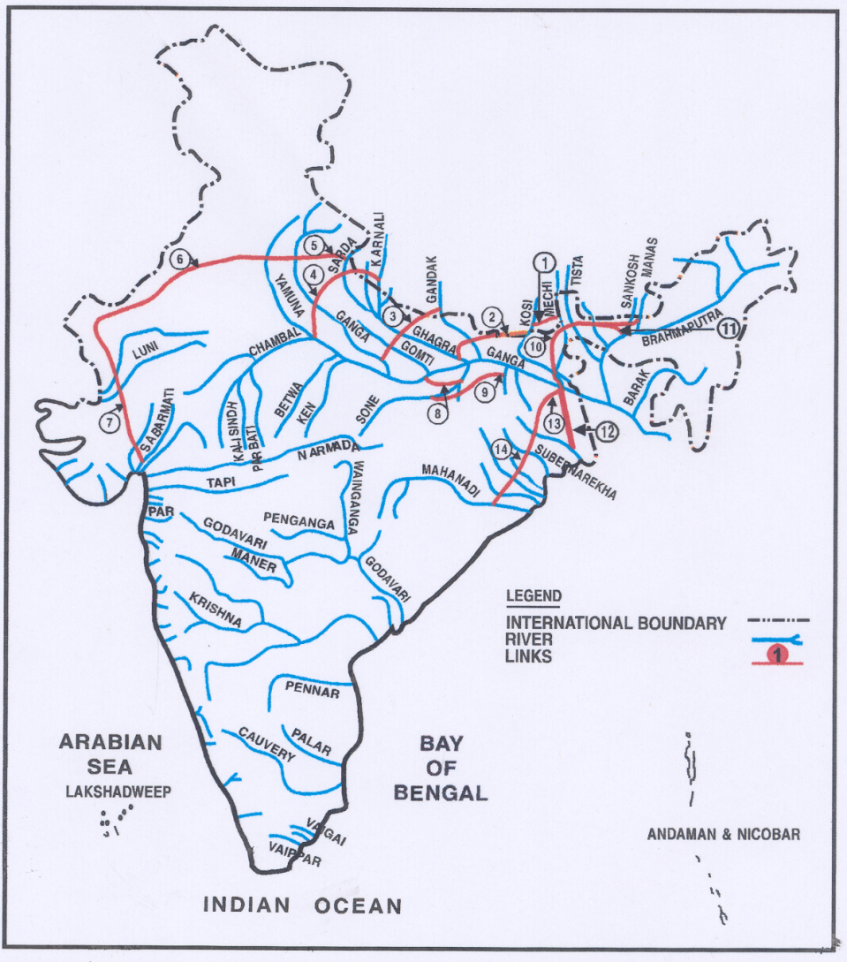
Inter State River Basins suggested to be brought in, in the 1st Phase of RBA
Brahamani-Baitarini basin
Cauvery basin,
Ganga basin
Godavari basin,
Indus basin,
Krishna basin
Mahanadi basin,
Mahi basin
Narmada basin,
Pennar basin
Subarnreakha basin
Tapi basin

Slide 28
Elements of River Basin Master Plans
(to be evolved by RBOs, after their launch)
Basin Features, hydrology and yield (both SW and GW) including data collection aspects,
potential storage and diversion sites, existing and ongoing schemes for irrigation, hydroelectric power generation, water supply, flood control and Drainage, water treatment plants, Quality and quantity of hot spots etc
inventory of existing water uses in the basin, temporal and spatial distribution of the uses, source wise and area wise
water account comprising of qualitative as well as quantitative availability and utilisation (consumptive and non-consumptive)
Development needs,
Accounting for needs for aquatic ecosystem in rivers, reservoirs and lakes; making specific allocation of ecosystem needs, water and soil conservation, prevention and control of sedimentation
development scenarios including possibility of integrating various uses of water, integrating various reservoir systems, conjunctive use of surface and ground water, integrating ecological needs and incorporation of inter-State/international agreements and tribunal awards
River Basin Master Plan would be a dynamic document moving with times

Slide 29
As to Why the proposed RBM Act?
A recapitulation…
The legal framework for constituting an Inter-State River Basin Organization is contained within the Constitution of India itself & the Constitution of India has vested powers on the Parliament of India for the
  “Regulation and development of Inter State Rivers and river valleys to the extent to which such regulation and development under the control of the Union is declared by Parliament by law to be expedient in the public interest” by virtue of Entry 56 of List I of the Seventh Schedule to Article 246 of the Constitution.
In pursuance of this power that the Parliament had enacted the River Boards Act, 1956 (Act 49 0f 1956).
HOWEVER…
Contd….

Slide 30
As to Why the proposed RBM Act? …2
No single River Board was, in fact, constituted under the RBA, earlier promulgated. The States have not responded to the legal space for River Boards created under the River Boards Act, 1956 and this has meant that the Act has fallen into disuse. This is largely due to the fact that in Section 4(1) of the Act, the exercise of power of the Government of India to establish a River Board was incidental to a request received from the State government and no State Government ever made a request under the said section of the River Boards Act, 1956.
The River Boards Act, 1956 also does not provide for any river basin planning. In fact the integrated planning, development and management of water resources of the river basin were not contemplated explicitly at the time of enactment of the River Boards Act, 1956.
Understandably, the IWRM was not a concept of that era. The concept of IWDRM more commonly known as IWRM attained importance due to the water scarcity world wide, in the later decades, impacting highly populated countries, more & more. IRBM shall take on board IWRM concept to the extent possible. Besides, all the more, in a broader sense, integrated resources management concepts, aligning it to NDP would be the aim with the GC role in approving RB Master Plans.

Slide 31
As to Why the proposed RBM Act? …3
The IRBM approach shall ensure that the current demands for water are met without jeopardizing the ability of future generations to meet theirs.
Overall, it helps to advance the country’s social and economic development goals in ways that do not compromise the sustainability of vital ecosystems to the extent desirable and feasible.
IN THE END,
I am at your disposal to provide clarification if any, required.
Questions /comments are welcome. JAI HIND

Slide 32
Thank you for your Patience

